Slide 1
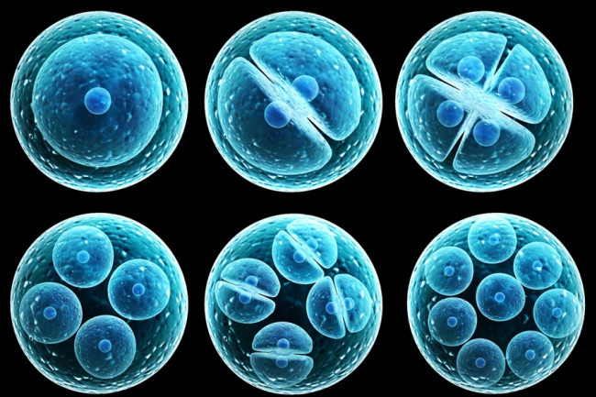
BS20001 | Science of Living Systems
Cell and Developmental Biology
Abhijit Das | School of Bioscience | IIT Kharagpur
Email: abhijit.das@iitkgp.ac.in | Tel: 03222-260511

Slide 2
Topics
Microscopy
Prokaryotic and Eukaryotic Cells
Development of Multicellular Organisms
Mitosis
Meiosis
Differentiation
Stem cells and their applications

Slide 3
Microscopy techniques to study cell biology
Microscopes are used to observe small objects invisible to the eye.
The quality of the image depends on:
Magnification: the microscope’s power to increase an object’s apparent size
Resolution: minimum distance between two distinguishable points
Contrast: visible differences between different parts of the sample

Slide 4
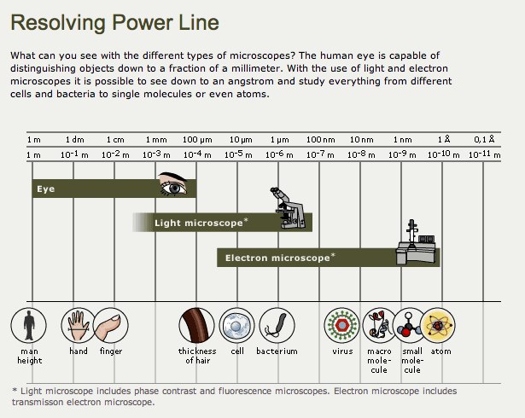

Slide 5
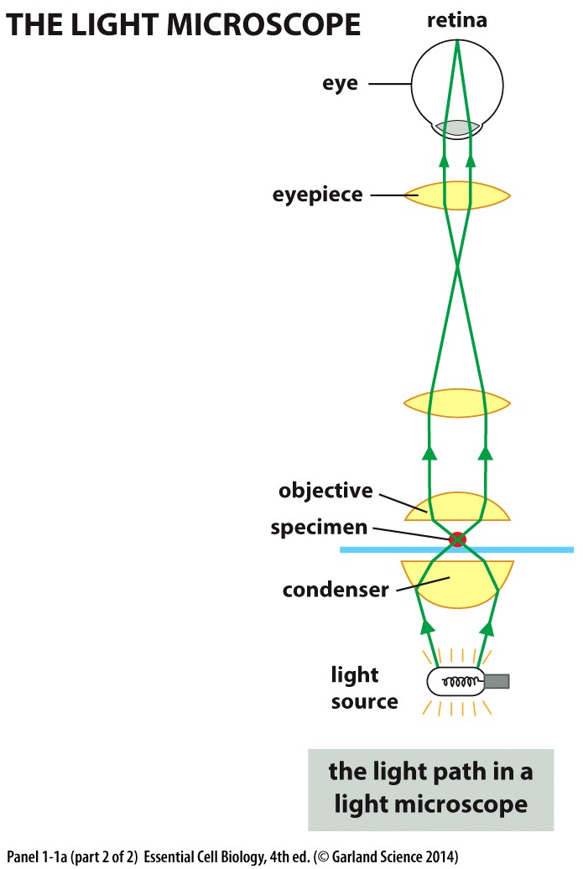
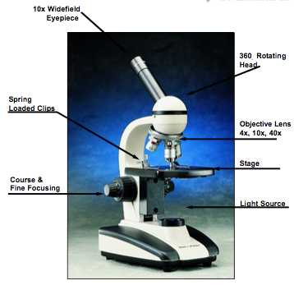
Up to 0.2 μm

Slide 6
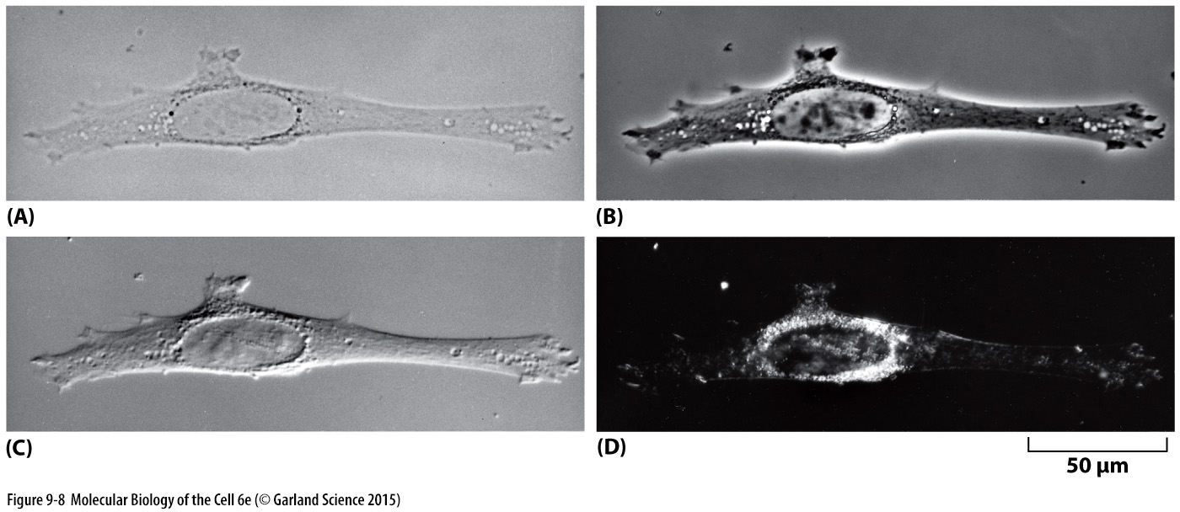
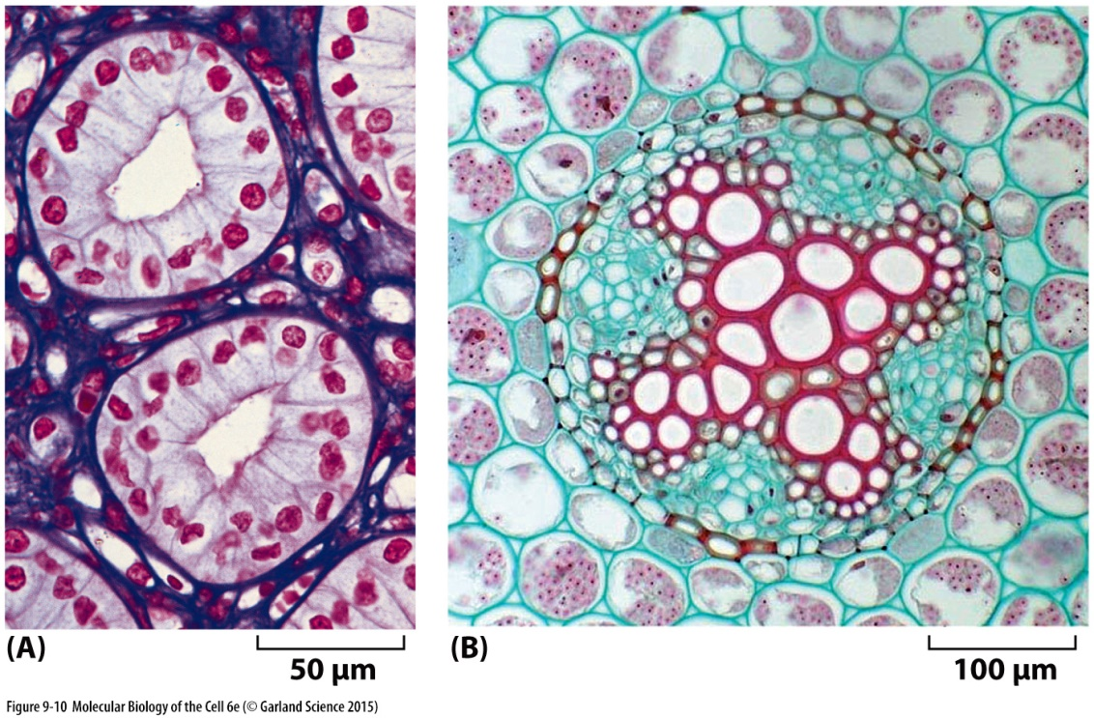
Microscope Contrast
Specimen Contrast
Bright field
By selective and differential staining of cellular components
Differential Interference Contrast
Phase contrast
Dark field

Slide 7
Electron Microscopy
Subcellular structures are studied by electron microscopes. They are of two types:
Scanning Electron Microscopes (SEM) focus a beam of electrons onto the surface of the sample and provide images that give 3D representation of the sample. SEM is used to study surface structure of objects
Transmission Electron Microscopes (TEM) focus a beam of electrons through the sample. TEMs are used to study the internal structure of the cell

Slide 8
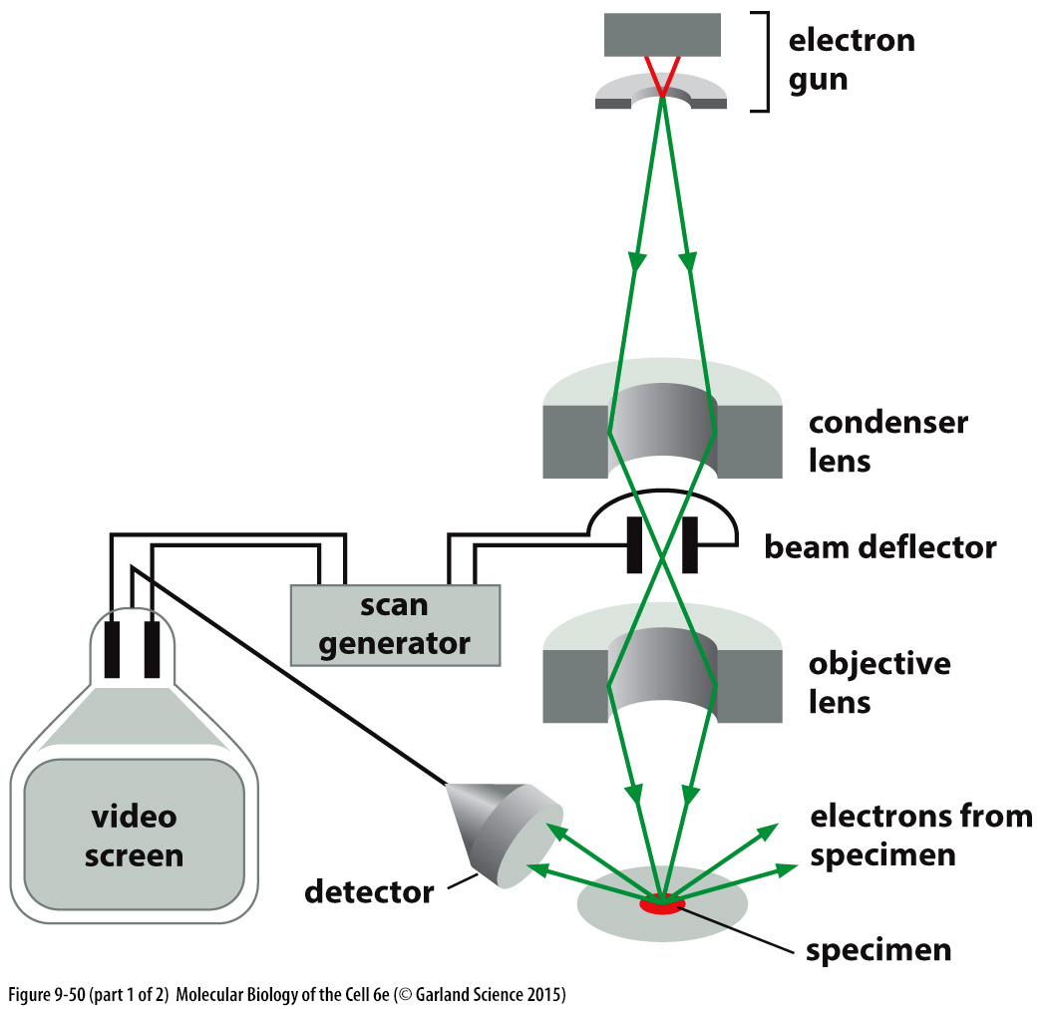
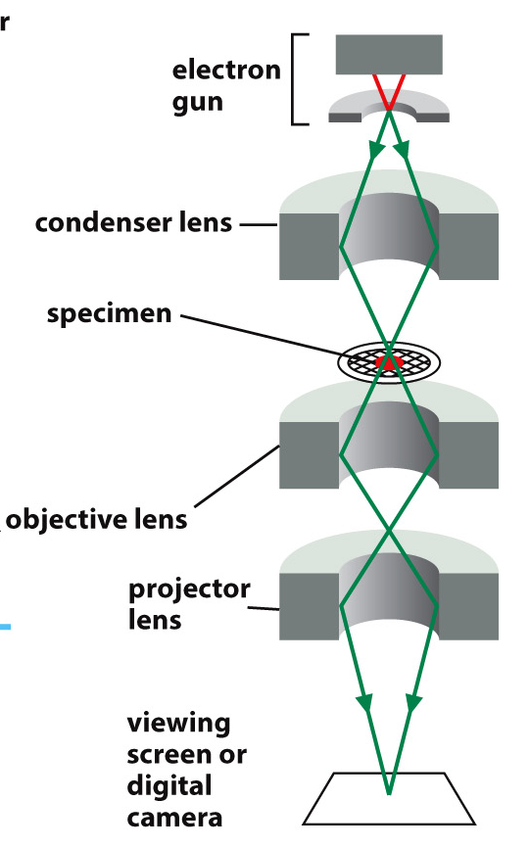
Electron Microscopy: SEM vs TEM
Scanning Electron Microscope (SEM)
Transmission Electron Microscope (TEM)
Notes:
Electromagnetic lens

Slide 9
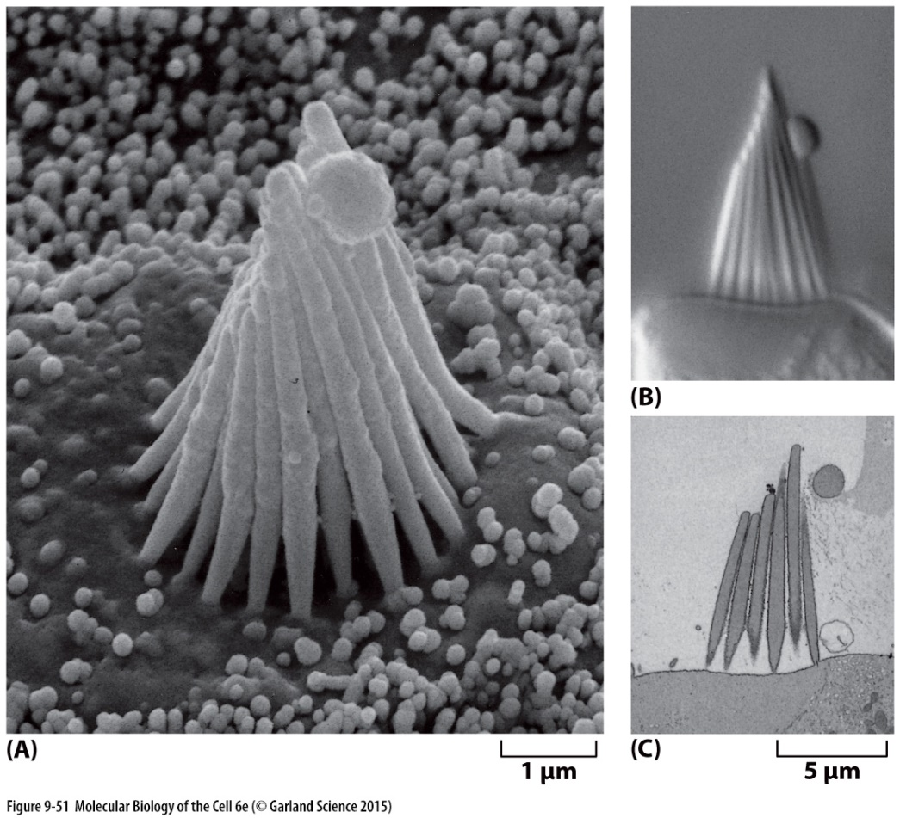
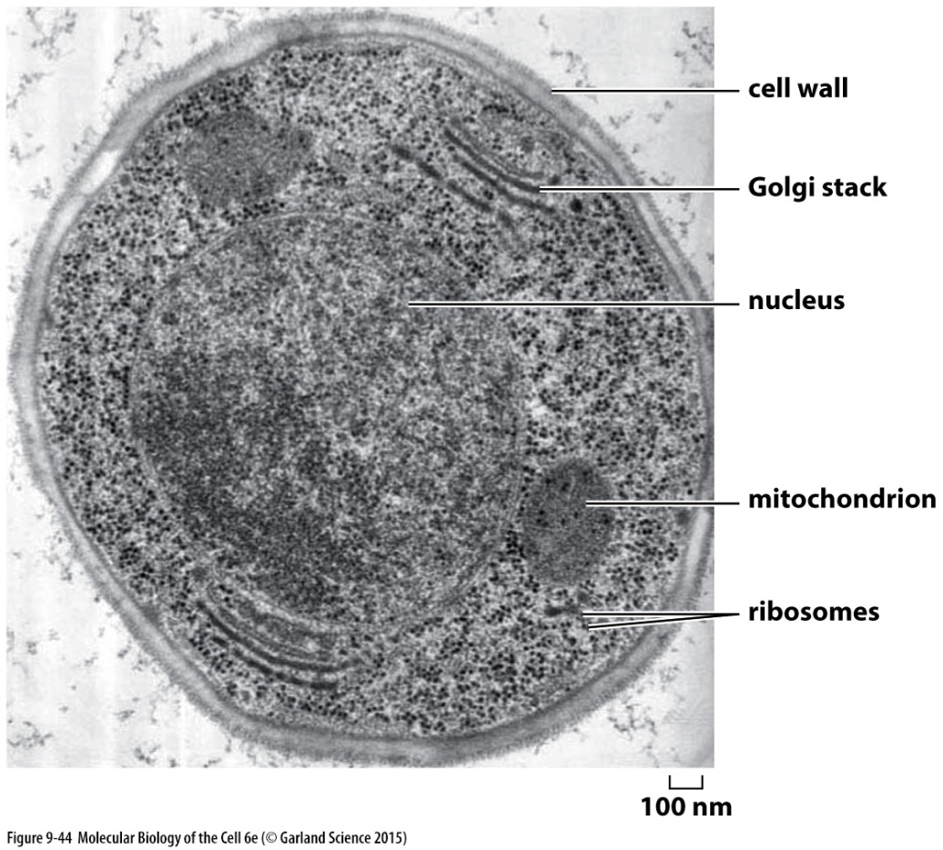
Electron Microscopy: SEM vs TEM
Scanning Electron Microscope (SEM)
Transmission Electron Microscope (TEM)
Surface features
Intracellular ultrastructure

Slide 10
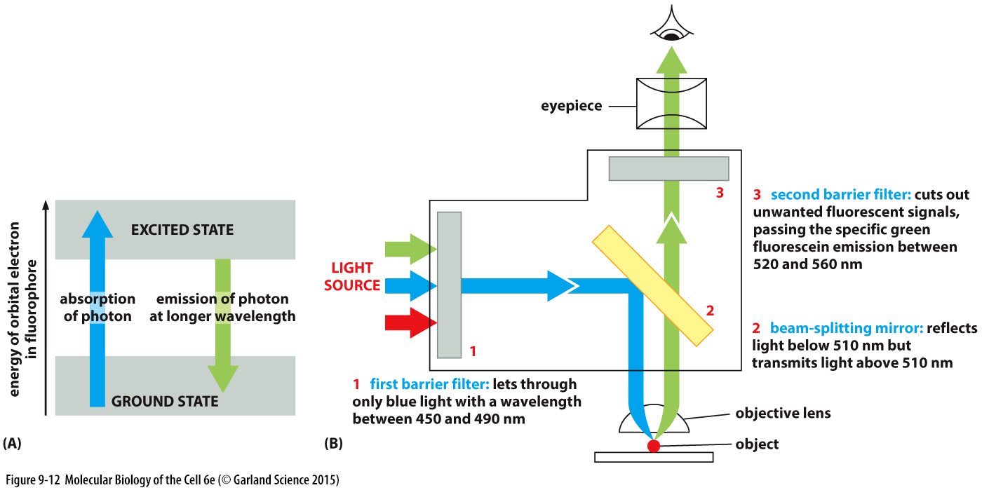
Fluorescence Microscope

Slide 11
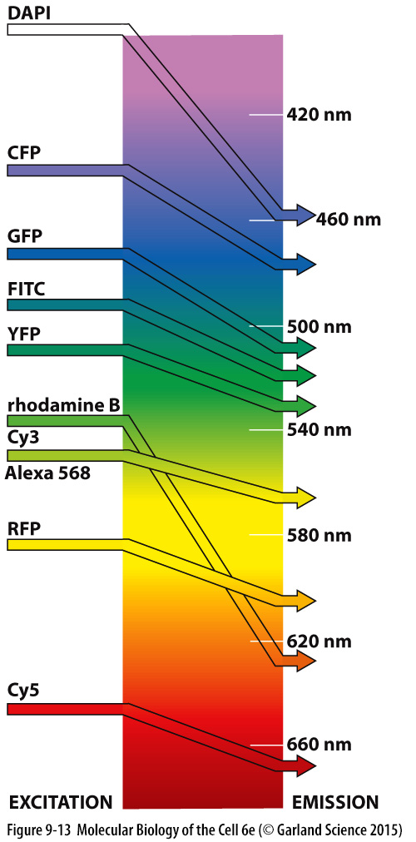
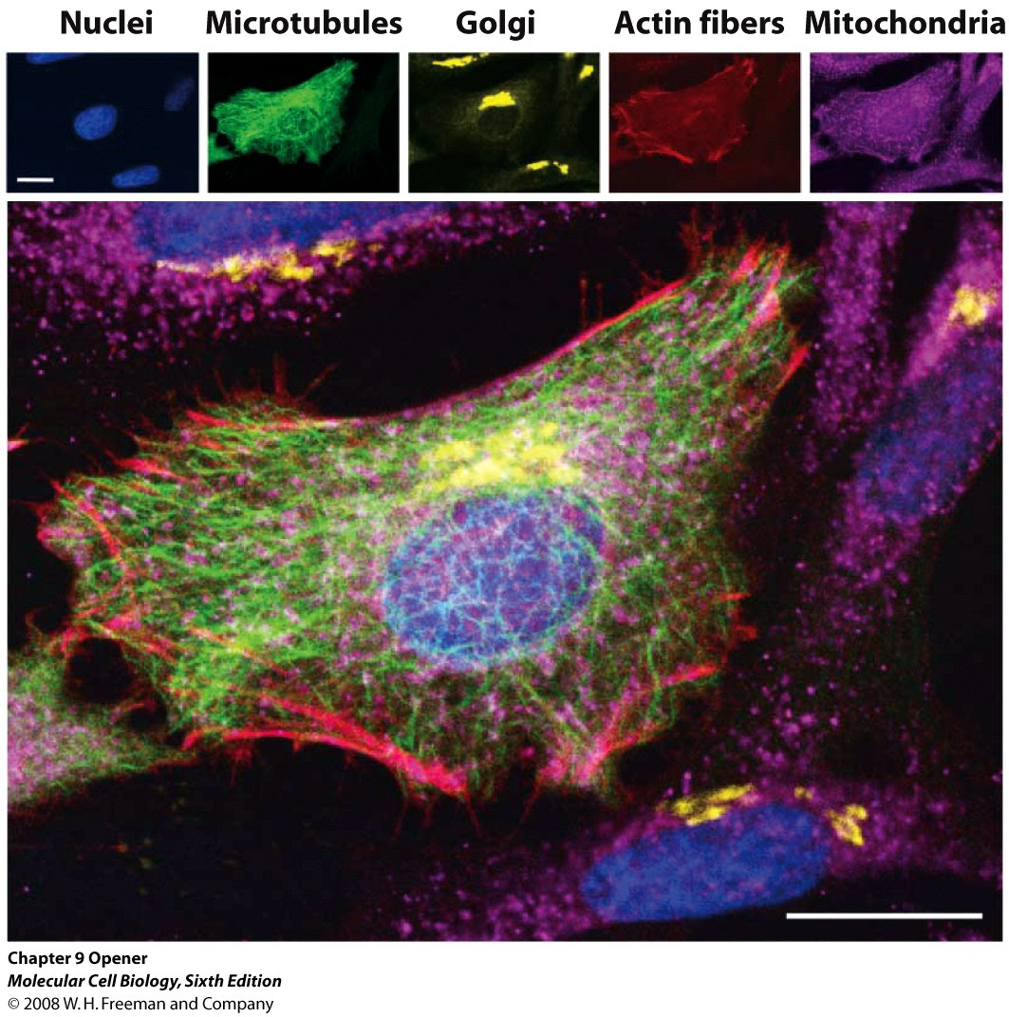

Slide 12
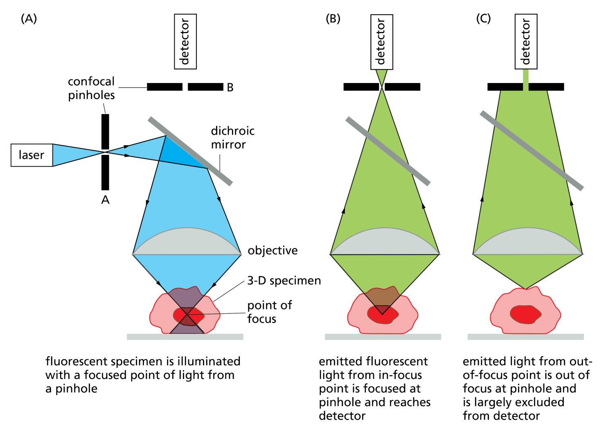
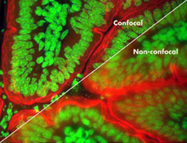
Confocal microscope
A pinhole focuses the illumination at a point
Another pinhole collects emitted light (signal) only from a point (focus)
Noise from out of focus points in specimen is excluded
Point of focus of illuminating light
and emitted light are same

Slide 13
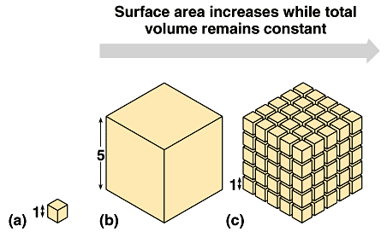
Why are Cells Small?

Slide 14
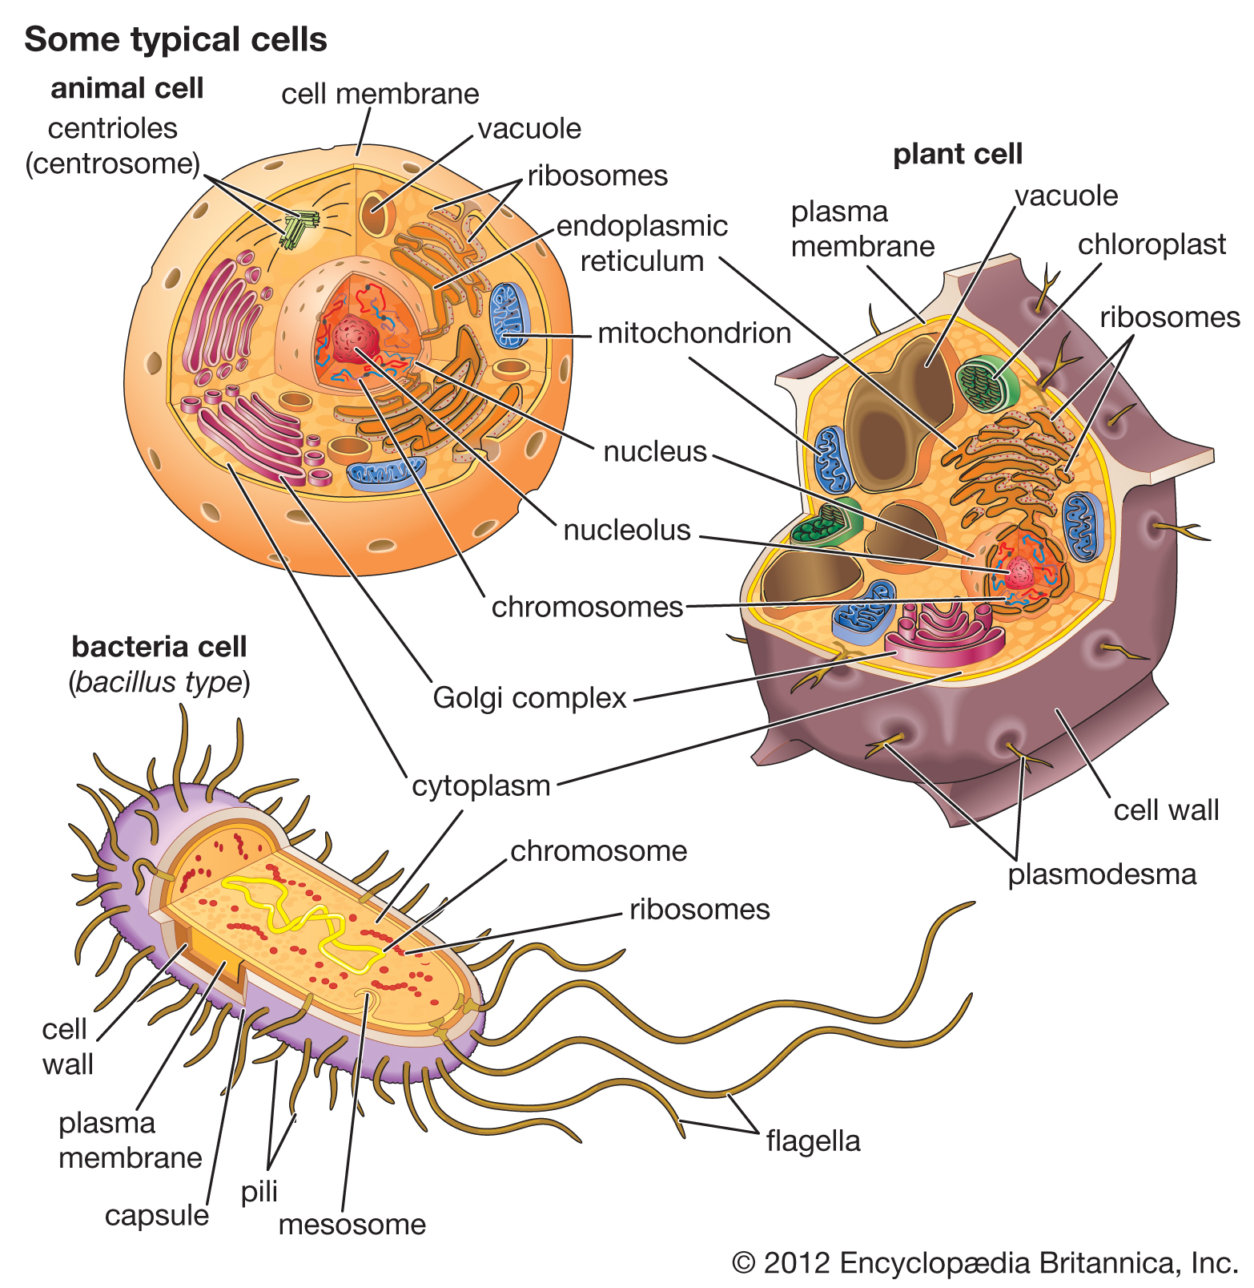

Slide 15
Prokaryotic and Eukaryotic Cells
Prokaryotic cells | Eukaryotic cells
No membrane-enclosed intracellular compartment to house genetic material (DNA) | Have well defined nucleus (membrane-enclosed intracellular compartment) to house genetic material (DNA)
Prokaryotic cells lack most of the complex membrane bound internal organelles | Eukaryotic cells have well defined and complex membrane bound internal organelles
Prokaryotic cells have a single circular chromosome | Eukaryotic cells have paired chromosomes
Prokaryotic cells lack histone proteins; | Eukaryotic cells have histone proteins
Prokaryotic cell wall has peptidoglycan. | Plant and fungal cells have both cellulose and chitin in cell wall. No such cell wall in animal cells

Slide 16
Bacterial Cell Wall
Lies outside the cell membrane in nearly all bacteria (except mycoplasma and some archaebacteria)
Two important functions:
Maintains the characteristic shape
Prevents osmotic lysis

Slide 17
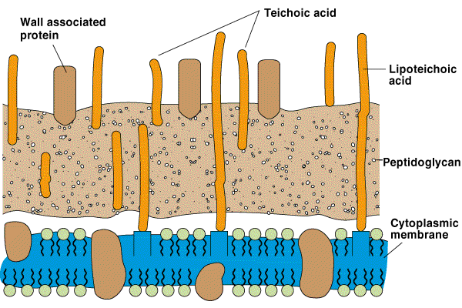
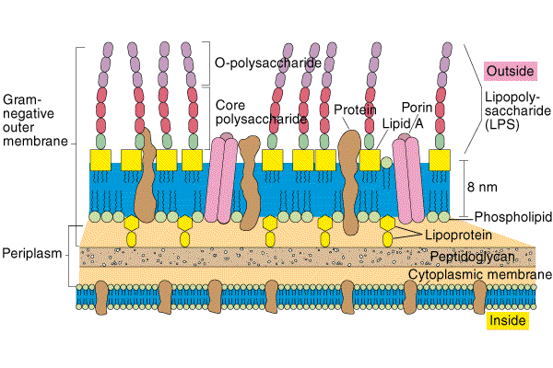
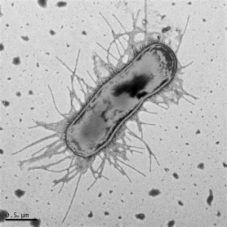
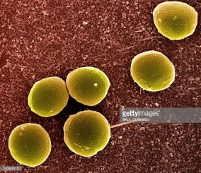
Bacterial Peptidoglycan Layer
Gram +ve
S. aureus
Gram –ve
E. coli

Slide 18
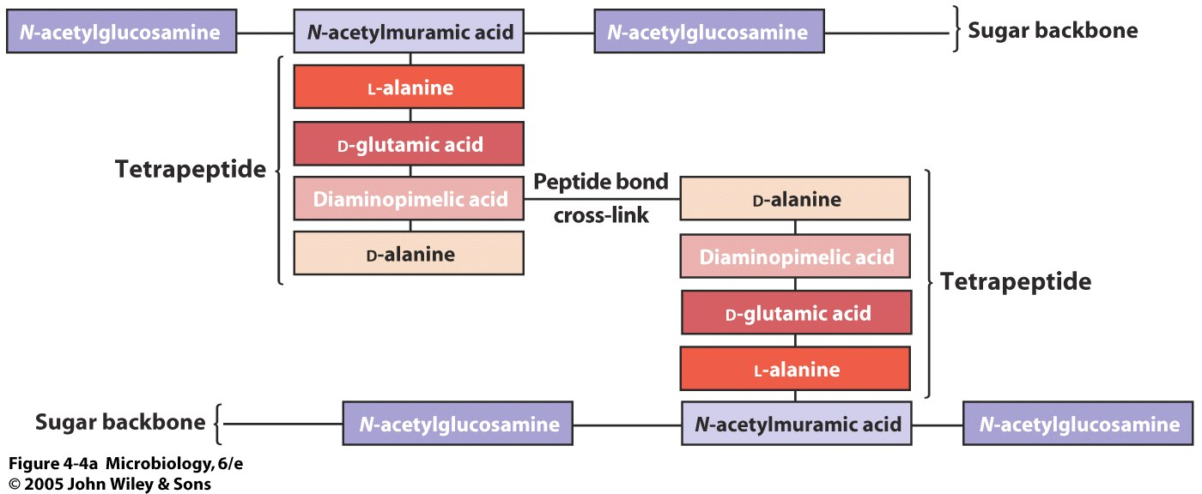
Components of Bacterial Peptidoglycan Layer
(NAG)
(NAM)
(NAG)
Gram –ve bacteria like E. coli

Slide 19
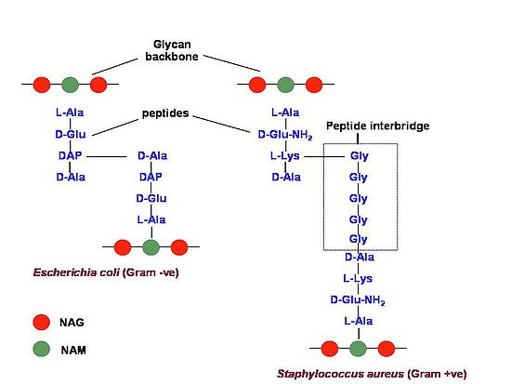
Components of Bacterial Peptidoglycan Layer
Gram+ve vs Gram-ve

Slide 20
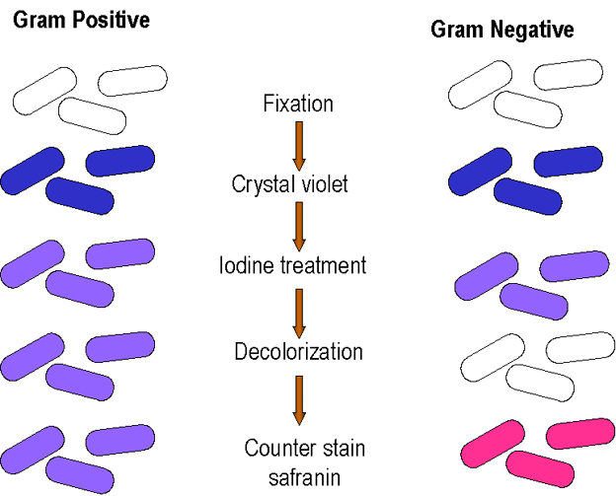
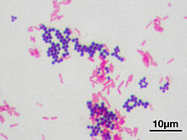
Gram Staining
A Gram stain of mixed Staphylococcus aureus (Gram positive cocci) and Escherichia coli (Gram negative bacilli), the most common Gram stain reference bacteria

Slide 21
Controlling Bacteria by Damaging Cell Walls
The antibiotic penicillin blocks the final stages of peptidoglycan synthesis
The enzyme lysozyme, found in tears and other human body secretions, digests peptidoglycan

Slide 22
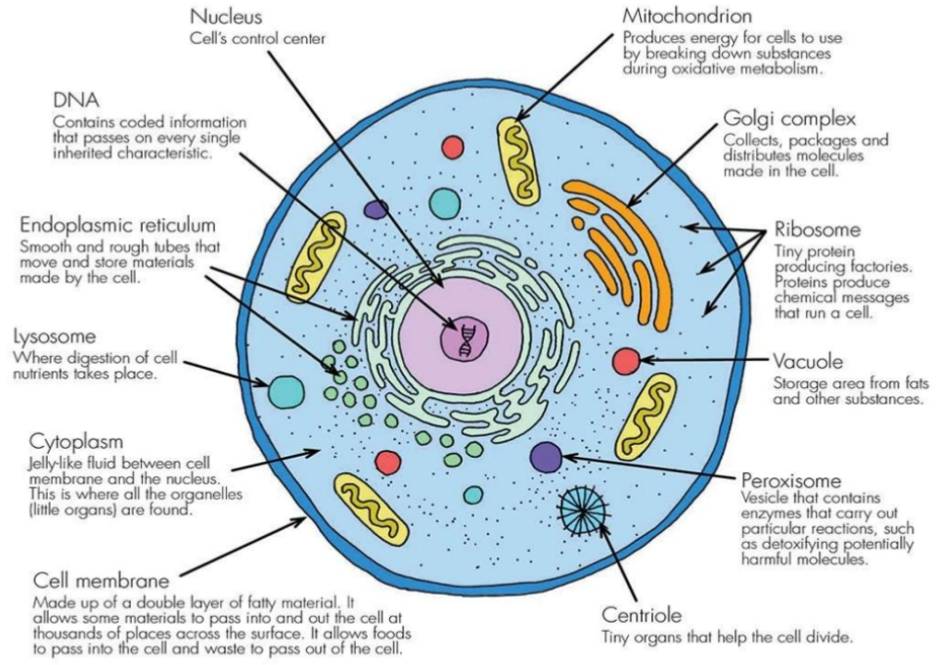
Eukaryotic cellular compartments and their functions

Slide 23
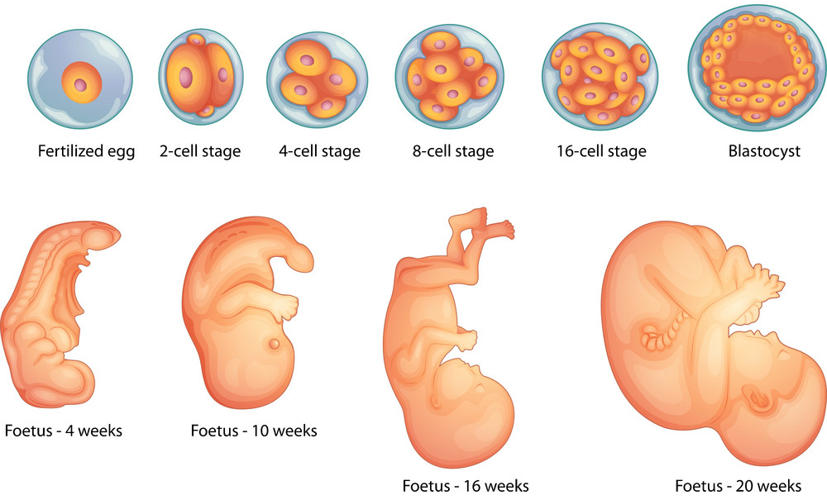
Development of Multicellular Organisms

Slide 24

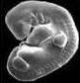
Cycle of life depends on two modes of cell division
Mitosis
Fertilization
Zygote
(single cell)
Sperm
Ovum
Morula
(Multicellular)
Meiosis
Mitosis and Differentiation
Adult
Embryo
Mitosis and Morphogenesis
Notes:
Mitosis: Cell duplication for development of organism
Meiosis: Generation of sex cells for reproduction

Slide 25
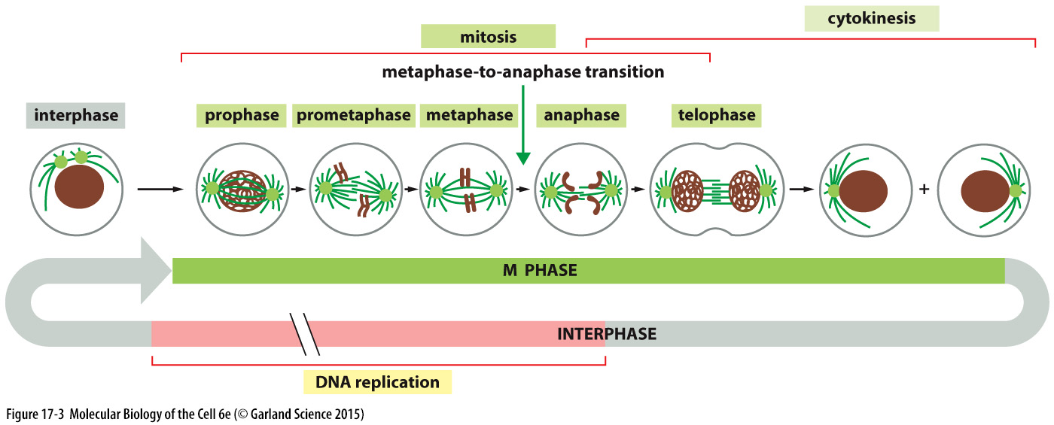
Expansion of Zygote (single cell ) to adult human (10¹³ cells): Mitosis cell division
Division of 1 parent cell produces 2 daughter cells
Chromosome number remains same after Mitosis (2n to 2n)- equational division
Replication doubles the genomic content (2c to 4c), Mitosis halves it (4c to 2c)

Slide 26
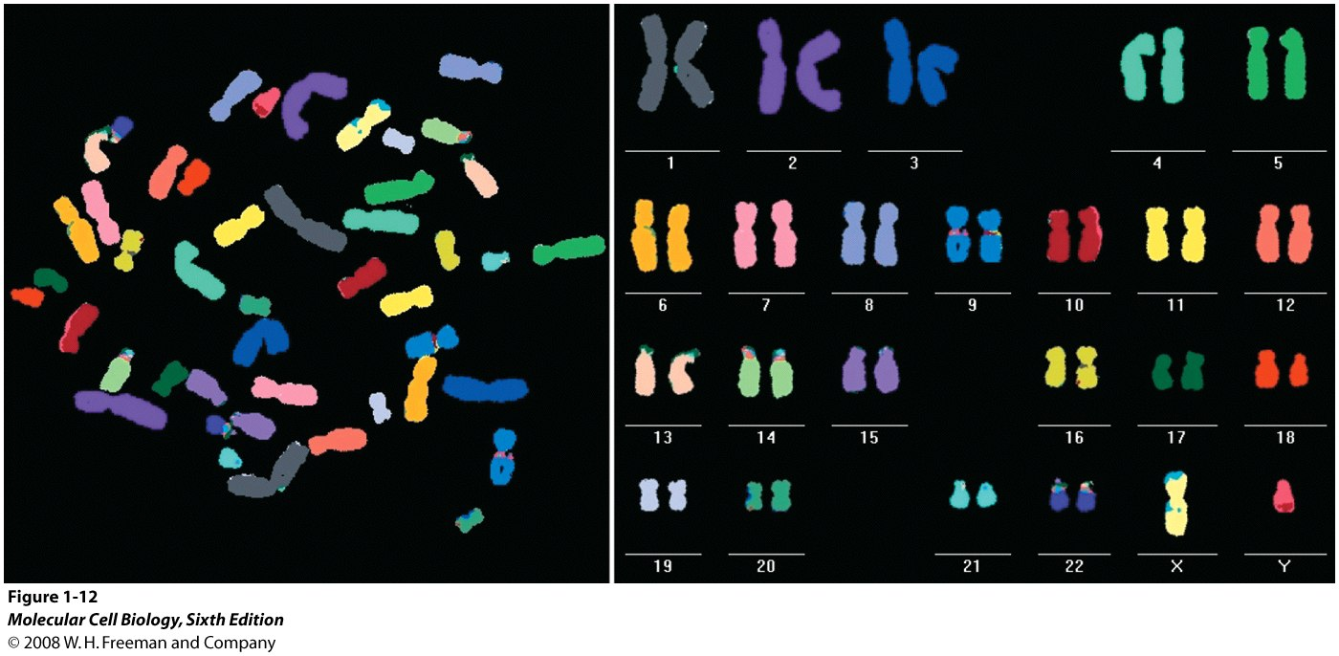
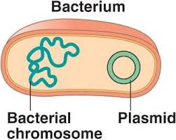
Accurate Distribution of DNA during cell division:
A challenging task considering the complexity of our genome
Genome: The complete genetic information (i.e., total DNA content) carried by a cell or organism
Human genome is divided into 23 pairs of chromosomes
Bacterial genome is present in a single circular chromosome
Human

Slide 27
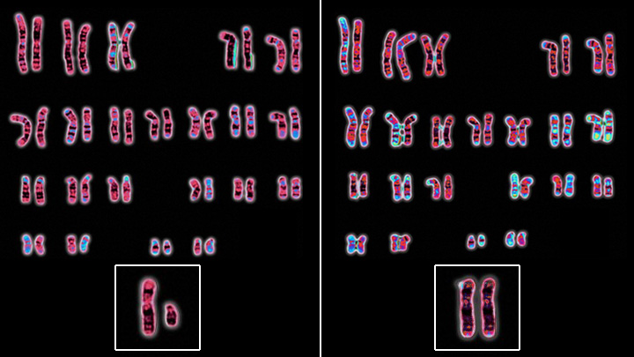
Two copies of Genome (2n) in each body cell
Most of the higher eukaryotes are diploid (2n) i.e. their body (somatic) cells contain two copies of the basic genome set (two sets of homologous chromosomes)
Male
Female

Slide 28
One copy of Genome (n) in each Sperm/Ovum
The gametes of most higher eukaryotes are haploid (n) i.e. these cells contain one copy of the basic genome set (one set of chromosomes)
Somatic Cells (2n)
Somatic Cells (2n)
Gametes (n)
Mitosis
Meiosis
(22 x 2) + XX
22 + X
Egg
2n
F
Mitosis
Meiosis
22 + X
or
22 + Y
Sperm
(22 x 2) + XY
Sperm
2n
M

Slide 29
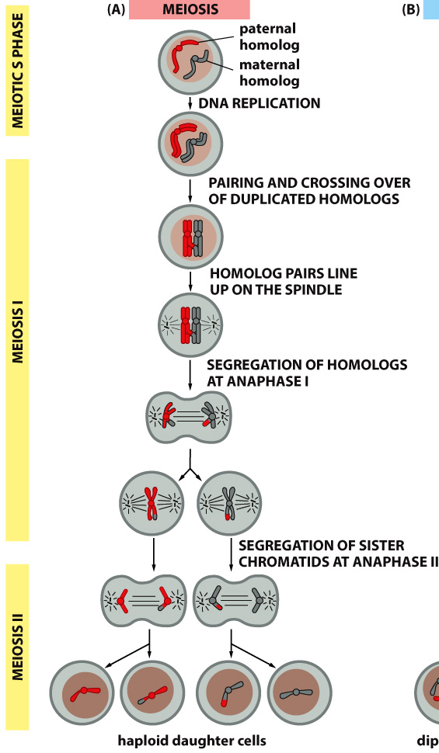
Production of sex cells (gametes): Meiosis cell division
Two rounds of division of 1 parent cell produces 4 daughter cells
Chromosome number becomes half after Meiosis; i.e. diploid (2n) cell divides to generate haploid (n) gametes- reductional division
Replication doubles the genomic content (2c to 4c), Meiosis reduces it (4c to c)
Spermatogenesis
Oogenesis
2n
2n
n
n
Meiosis
n
n
n
n
n
n
n
n
n
n
Ovum
Sperms

Slide 30
Mitosis vs Meiosis
Mitosis (equational division): Somatic (body) cells increase in number in this mode
Meiosis (reduction division): Specialized diploid cells (meiocytes) undergo two sequential nuclear divisions to form four haploid gametes (sperms and eggs in plants, animals) or spores (fungi, algae).
 | Mitosis |  | Meiosis
 | Chromosome sets | Genomic content | Chromosome sets | Genomic content
Parent cell | 2n | 2C | 2n | 2C
Genome duplication | 2n | 4C | 2n | 4C
Progeny cells | 2n | 2C | n | C
→
→

Slide 31
Diploid (2n) Genome arises by Fertilization
Through Fertilization of two haploid gametes, i.e., one genome set (n) from male gamete (i.e. sperm) and another genome set (n) from female gamete (i.e. egg).
Gamete formation (2n → n)
Fertilization (n + n → 2n)
Meiosis
Egg: 22 + X
(n)
2n
F
2n
F
Meiosis
Sperm: 22 + X
(n)
Sperm: 22 + Y
(n)
2n
M
2n
M

Slide 32
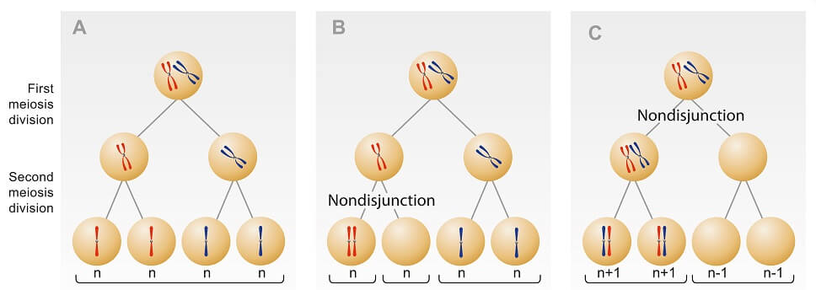
Nondisjunction
Failure of separation of homologous chromosomes or sister chromatids during meiosis
Some diseases caused due to Nondisjunction:
Down syndrome (trisomy 21): It is the most common irregularity of chromosome number in humans. Children with Down syndrome have severe mental illness. Advanced maternal age is the risk factor for DS
Turners syndrome (X monosomy: 45, X0)
Notes:
Cause of DS:
Due to the prolonged arrest of human oocytes
Weakening of cohesive ties holding chromosomes together
Reduced activity of the spindle assembly checkpoint

Slide 33
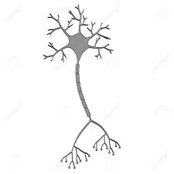
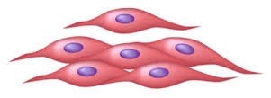
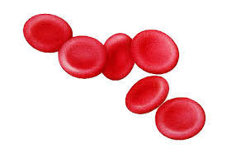


How do so many types of cells arise in our body: Differentiation
Expression of tissue-specific genes (TSGs) dictate differentiation path towards a specific cell identity
In contrast, House keeping genes (coding for RNA Polymerase, Ribosomes, Cytoskeletal proteins etc.) are expressed in all cells
Zygote
Cell division
Differentiation
Muscle:
Myoglobin
Neurotransmitter
Hemoglobin
Neuron:
Myoglobin
Neurotransmitter
Hemoglobin
RBC:
Myoglobin
Neurotransmitter
Hemoglobin
How do different genes express in different cells?

Slide 34
Differentiation: Two ways of making sister cells different
Asymmetric Cell division: Some proteins and/RNA gets asymmetrically distributed in dividing cell; after division, they distribute unevenly in the to daughter cells
Extrinsic Signal: Neighbouring cells or secreted signalling molecules act on one of the two post-mitotic daughter cells to assign a specific identity

Slide 35
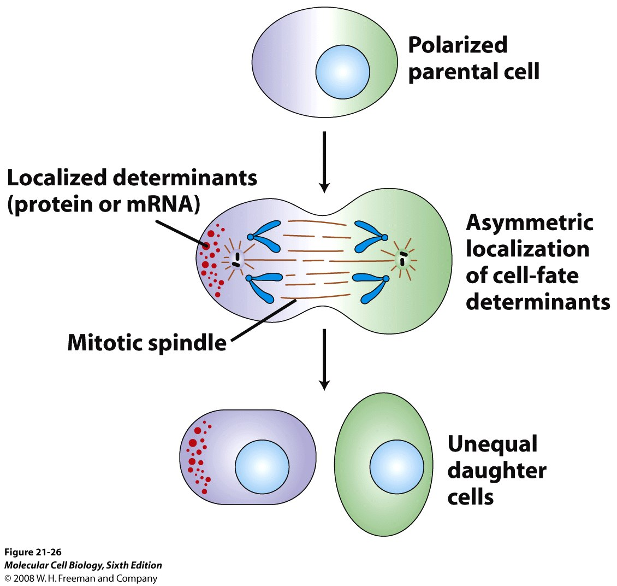
Asymmetric division leads to different cell fates
Essential to asymmetric cell division is polarization of the parental cell and then differential incorporation of parts of the parental cell into the two daughters
Some cytoplasmic components (such as mRNA or proteins) are localized in some part of the cell
The unequal distribution of these components to the daughter cells typically result in transcription of different sets of genes
The resulting proteins determine the cell-fate

Slide 36
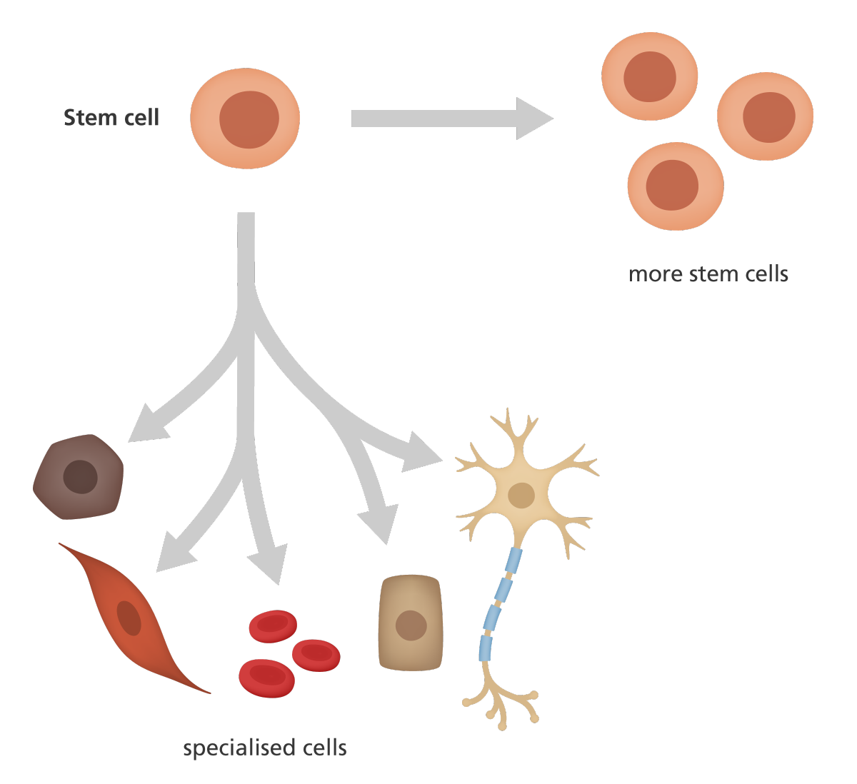
What is a stem cell?
Stem cells are undifferentiated cells in multicellular organisms, which can proliferate indefinitely and generate multiple cell types
Stem cells are present in embryos as well as in adults
Adult stem cells are found in:
Bone marrow
Brain
Gonads
Gut
Eye
Skin

Slide 37
Important properties of stem cells
1. Totipotency: Ability to give rise a new organism
2. Pluripotency/multipotency: Ability to give rise to any/many cell types of our body
3. Self-renewal: Ability to reproduce/renew themselves repeatedly
4. Asymmetric cell division: Ability to divide asymmetrically to form one daughter stem cell identical to itself and one daughter cell that is different and usually of more restricted potential
In this way, mitotic division of stem cells preserves a population of undifferentiated cells while steadily producing a stream of differentiating cells.

Slide 38
Asymmetric cell division is essential to generate different cell types in multicellular organisms
SC
In multicellular organisms, stem cells can give rise to two different cells, one that resembles the parent cell and one that does not. Such asymmetric cell division generates all different cell types in the body
Daughter cells produced by such asymmetric cell division may differ in size, shape, composition of protein/RNA and most crucially in gene expression which confers different fates on the two cells
In symmetric cell division, the parental cell gives rise to two daughter cells that resemble each other, at least visually
NB
Asymmetric division
&
Self Renewal of the Stem Cell
SC
IP
SC
Symmetric
division
IP
SC
IP
Differentiating cells
SC= stem cell
IP= intermediate progenitor
Note: Genomic content is symmetrically segregated even in asymmetric division

Slide 39
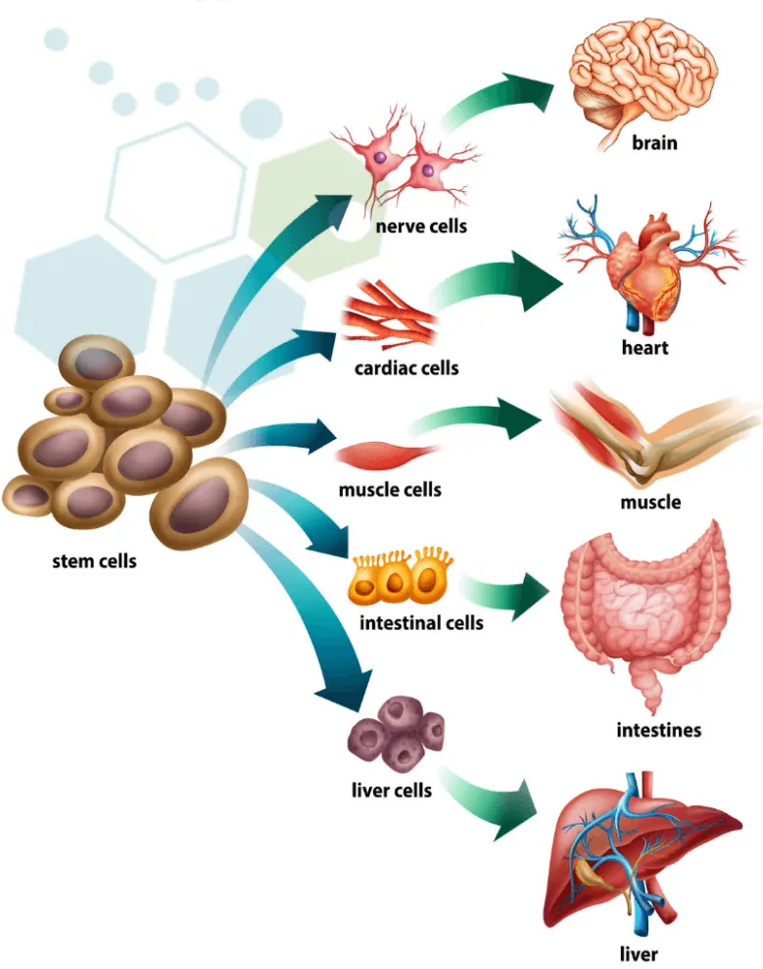
Potential Therapeutic Application of Stem Cells
ANY TISSUE/ORGAN
STEM CELL
TRANSPLANT INTO PATIENTS
For this purpose we need to obtain stem cells in large number.
Where do we find stem cells?

Slide 40
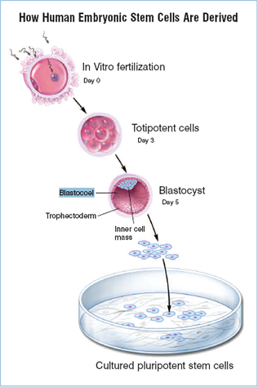
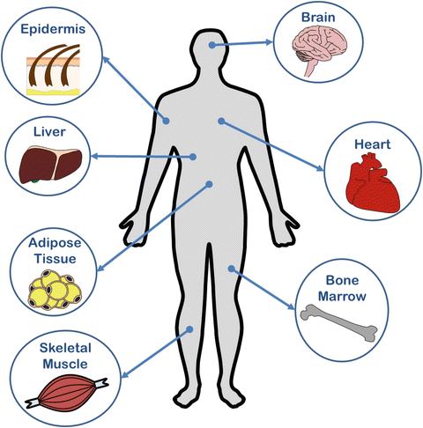
Sources of Stem Cells
1. Embryonic Stem (ES) Cells:
2. Adult Stem Cells:
Problem
Its extremely challenging to selectively isolate stem cells from other cells
Solution
Induced Pluripotent Stem Cells (iPSCs)

Slide 41
Induced pluripotency: Pluripotency can be artificially Induced in a differentiated cell
Reprogramming: Increase in potency and dedifferentiation of a somatic (differentiated) cells into induced Pluripotent Stem Cells (iPSCs)
Reprogramming can be induced by:
Nuclear transfer
Cell fusion
Genetic manipulation
Overexpression of a small set of transcription factors

Slide 42

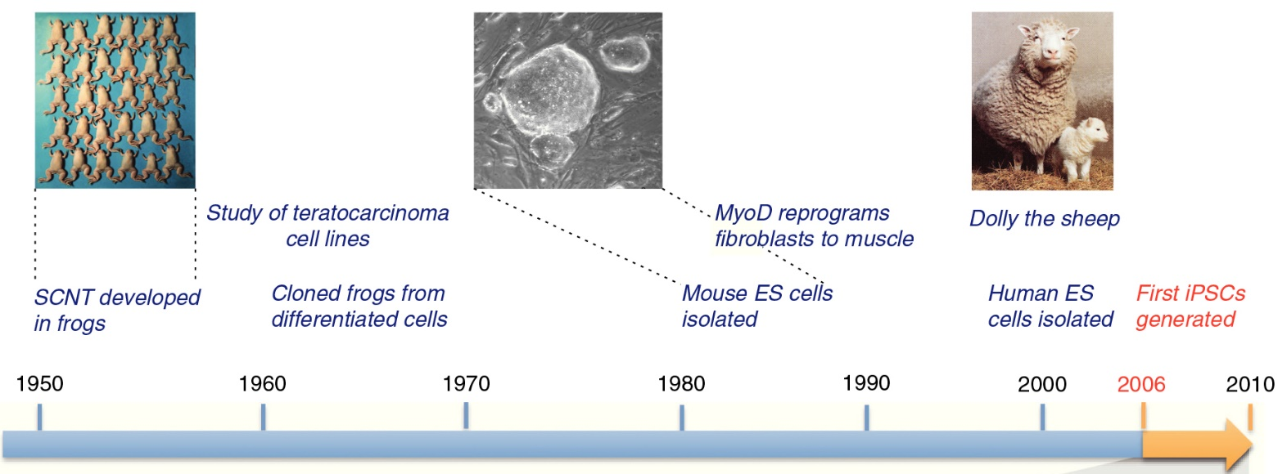
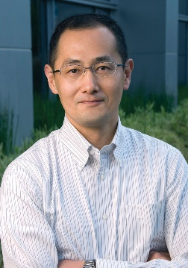
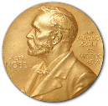
Major discoveries in reprogramming research
2012
2012

Slide 43
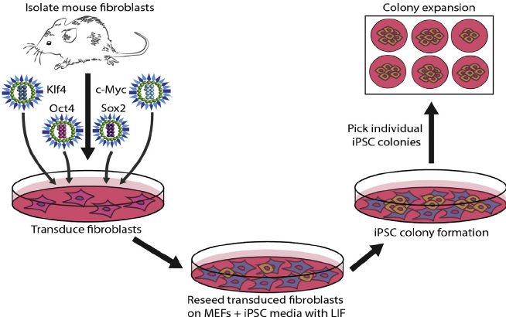
Derivation of first iPSC: Shinya Yamanaka and Kazutoshi Takahashi (2005)
Shinya Yamanaka
Yamanaka Factors
Culture in proper media

Slide 44
Biomedical applications of iPSCs
Regenerative medicine: To restore or replace damaged tissue
For example, neuronal cells that generated from iPSCs can be used to treat Parkinson’s disease patients who have lost neurons
Disease modelling: iPSCs generated from patients can be used to understand the disease pathology
Drug discovery: iPSCs from patients can be cultured in lab to screen for drugs that can repair the defects

Slide 45
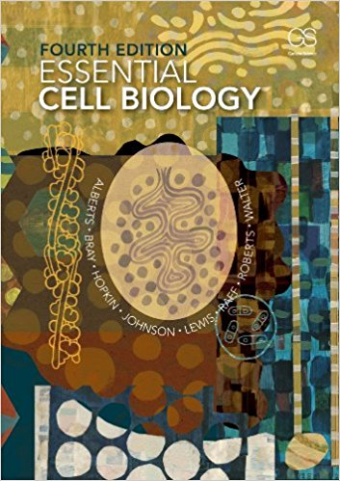
Books and resources
Video links:
https://www.youtube.com/watch?v=URUJD5NEXC8
https://www.youtube.com/watch?v=B_zD3NxSsD8

